Slide 1
Project Phase 1
Behavioural Wakefulness Verification System (BWVS) An Intelligent Non-Contact Wakefulness Verification System using
24 GHz mmWave Radar
Boys Batch -2
Team Members
Aswin Raaj .R (23BEE030)
Mani Balaji .S (23BEE043)
Tharun .V.S (23BEE057)
Guided by
Dr.G.Pandiaraj
Assistant Professor (Sl. Grade)
Electrical and Electronics Engineering

Slide 2
Problem Statement
The Problem:
Conventional alarm systems assume that waking up is a single event.
However, in reality:
Users often stop the alarm and immediately return to sleep.
Existing alarms only verify alarm dismissal.
Temporary body movement is mistaken as genuine wakefulness.
False wake-ups reduce productivity and affect daily routines.
Core Problem
Existing alarm systems cannot reliably distinguish between temporary awakening and sustained wakefulness.

Slide 3
Motivation
Why is this important?
Daily issues caused by ineffective wake-up systems:
Missing classes or work
Sleep inertia after alarm dismissal
Repeated snoozing
Lack of behavioural verification
No monitoring after alarm completion
Current systems answer:
"Was the alarm stopped?"
Our project answers:
"Is the user actually awake?"

Slide 4
Objective
Primary Objective :
Develop an embedded system capable of verifying sustained wakefulness using non-contact sensing.
Specific Objectives :
Detect human presence without wearable devices
Differentiate temporary movement from purposeful activity
Introduce a cognitive wake-up challenge
Monitor wakefulness after alarm dismissal
Reduce false wake-up confirmations
Log wakefulness sessions for later analysis

Slide 5
Literature Survey
Existing Method | Limitation
Conventional Alarm Clock | Stops after button press
Smartphone Alarm | Easily snoozed
PIR Motion Alarm | Detects only large movement
Camera-based Monitoring | Privacy concerns
Wearable Devices | User dependent
Smart Home Motion Detection | Cannot verify sustained wakefulness
Research Gap
No affordable embedded system verifies sustained behavioural wakefulness using non-contact sensing.

Slide 6
PIR vs mmWave
Feature | PIR | HLK-LD2410C mmWave
Detect Stationary Human | ✗ | ✓
Works in Darkness | ✓ | ✓
Motion Sensitivity | Low | High
Detection Reliability | Moderate | High
Micro-motion Detection | ✗ | ✓
Distance Tracking | ✗ | ✓
Suitable for Wakefulness Verification | Limited | Excellent
Selected Sensor: HLK-LD2410C

Slide 7
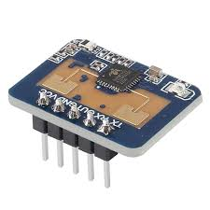
Why mmWave Radar?
The HLK-LD2410C radar continuously emits
24 GHz frequency-modulated electromagnetic waves.
By analyzing reflected signals, it can detect:
Human presence
Distance
Macro movement
Micro movement
Stationary things
Unlike PIR, it does not depend on infrared radiation.
The radar divides space into multiple configurable distance gates, allowing continuous tracking of human presence and movement.

Slide 8
mmWave Radar Data Sheet Study – HiLink(HLK) LD2410C
Detection angle: +/-60 deg
Resolution: 0.75m each (0 to 20 gates) – configured separately through HLK app via Bluetooth
Detection Range: 6m
Operating Voltage: 3.3v , Current Consumption: 80mA
Pins: TX, RX, GND, VCC, OUT ( 0 – human present, 1 – absent )
UART Communication: - sends a packet containing,
Target State (0-no target, 1-moving target, 2-stationary target, 3-moving+stationary)
Movement target distance
Stationary distance
Movement energy
Stationary energy
Detection distance

Slide 9
Working Principle of mmWave
24 GHz Signal
↓
Transmitted
↓
Reflects from Human Body
↓
Received
↓
Distance Calculation
↓
Movement Energy
↓
Presence Detection ↓
ESP32

Slide 10
Proposed Methodology
Challenge Phase
Activates cognitive response
Verification Phase
Observes behavioural activity
Stabilization Phase
Detects possible relapse into sleep
Logging
Stores wakefulness session for analysis
Alarm Trigger
↓
Challenge Phase
↓
Behaviour Verification
↓
Wake Stabilization
↓
Session Complete
↓
Data Logging

Slide 11
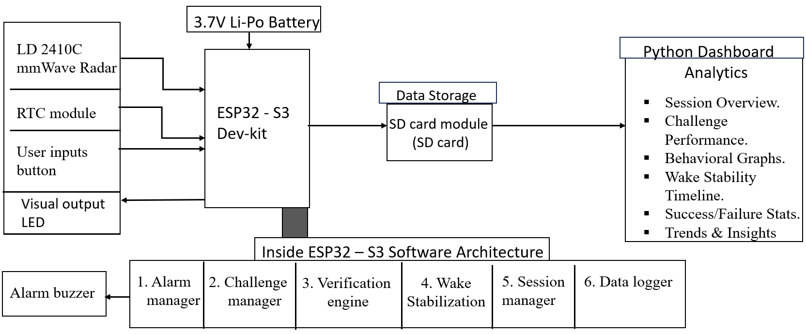
Block Diagram

Slide 12
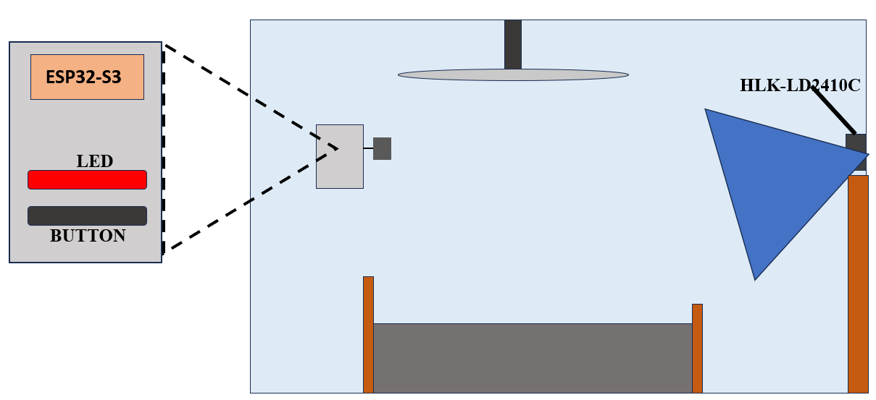
System Design

Slide 13
Hardware components
Component | Purpose
ESP32 – S3 | Main controller
HLK-LD2410C | Presence & movement sensing
RTC Module | Alarm scheduling
LEDs | Challenge indication
Push Buttons | Cognitive challenge
Buzzer | Alarm output
LDR | Ambient light detection (future support)
SD Card Module | Session logging
Power Supply | System power

Slide 14
Advantages
Non-contact operation
Privacy preserving
Detects stationary humans
Detects micro movements
Behavioural verification instead of simple motion detection
Multi-stage wake-up approach
Data logging support

Slide 15
Future Enhancements
Behavioural confidence scoring
Adaptive wakefulness models
Machine learning based personalization
Multi-sensor data fusion
Smart room integration
Long-term wakefulness analytics

Slide 16
GANTT CHART
Sl. No. | Task | July-26 | Aug-26 | Sep-26 | Oct-26 | Nov-26
1. | Title Selection, System Design, Components Selection
2. | Components Purchase and Assemble, System firmware design
3. | Testing and Validating prototype against edge cases
4. | Final Prototype and Report Submission

Slide 17
References
Hao, Z., Wang, Y., Li, F. et al. Detection of vital signs based on millimeter wave radar. Sci Rep 15, 28112 (2025). https://doi.org/10.1038/s41598-025-09112-w
En-Kang Wu, Qi-Gao Fan, Ming-Chao Li, Ji-Hao Zhang, Jie Jia, Tian Qiang, Cong Wang, Xiao-Feng Gu, Jun-Ge Liang,
Non-contact monitoring of human cardiorespiratory activity during sleep using FMCW millimeter wave radar, 2025, 116144,
ISSN 0263-2241, https://doi.org/10.1016/j.measurement.2024.116144.
M. Alizadeh, G. Shaker, J. C. M.c D. Almeida, P. P. Morita and S. Safavi-Naeini, "Remote Monitoring of Human Vital Signs Using mm-Wave FMCW Radar," in IEEE Access, vol. 7, pp. 54958-54968, 2019, doi: 10.1109/ACCESS.2019.2912956.

Slide 18
Thank You

